Slide 1
Tutorial 6
Statistical Computation and Analysis
Spring 2025

Slide 2
Tutorial Outline
Grid Method
MCMC
Metropolis-Hastings
Diagnostics
Convergence
Divergence

Slide 3
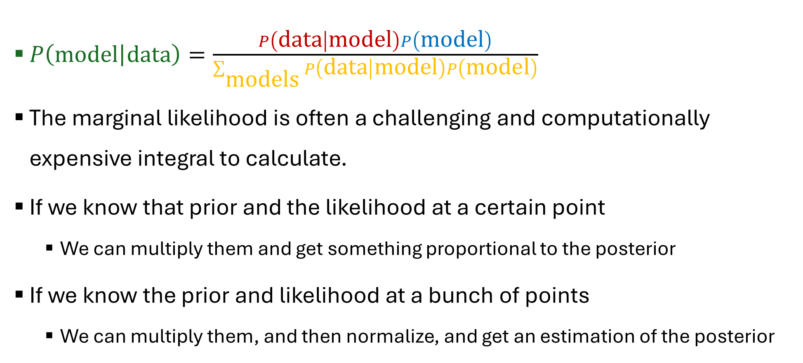
Grid Method
$P\left(\left.\text{model}\right|\text{data}\right)=\frac{P\left(\left.\text{data}\right|\text{model}\right)P\left(\text{model}\right)}{\sum_{\text{models}}{P\left(\left.\text{data}\right|\text{model}\right)P\left(\text{model}\right)}}$
The marginal likelihood is often a challenging and computationally expensive integral to calculate.
If we know that prior and the likelihood at a certain point
We can multiply them and get something proportional to the posterior
If we know the prior and likelihood at a bunch of points
We can multiply them, and then normalize, and get an estimation of the posterior

Slide 4

Grid Method
In the past we looked at the question: How many emails do you receive each day?
Likelihood:
For n iid observations:
$P\left(data | λ\right)=\prod_{i=1}^{n}{\frac{λ^{k_{i}}e^{−λ}}{k_{i}!}}=\frac{λ^{\sum_{i=1}^{n}{ki}}e^{−nλ}}{\prod_{i=1}^{n}{k_{i}!}}$
$S=\sum_{i=1}^{n}{ki}$ (total number of observed events)
$P\left(data | λ\right)=\prod_{i=1}^{n}{\frac{λ^{k_{i}}e^{−λ}}{k_{i}!}}=\frac{λ^{S}e^{−nλ}}{\prod_{i=1}^{n}{k_{i}!}}$

Slide 5
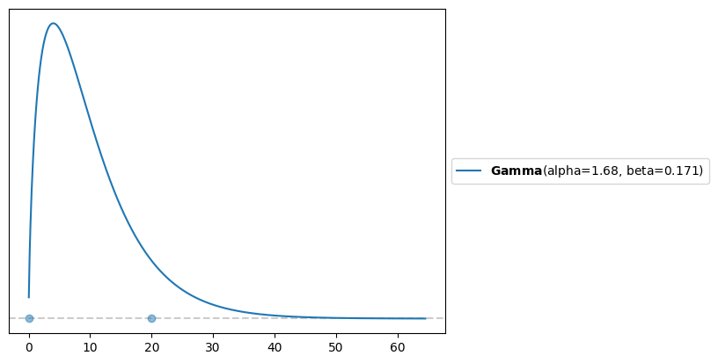

Grid Method
Prior:
$P\left(λ\right)\sim Gamma\left(α, β\right)=\frac{β^{α}λ^{α−1}e^{−βλ}}{Γ\left(α\right)}$

Slide 6
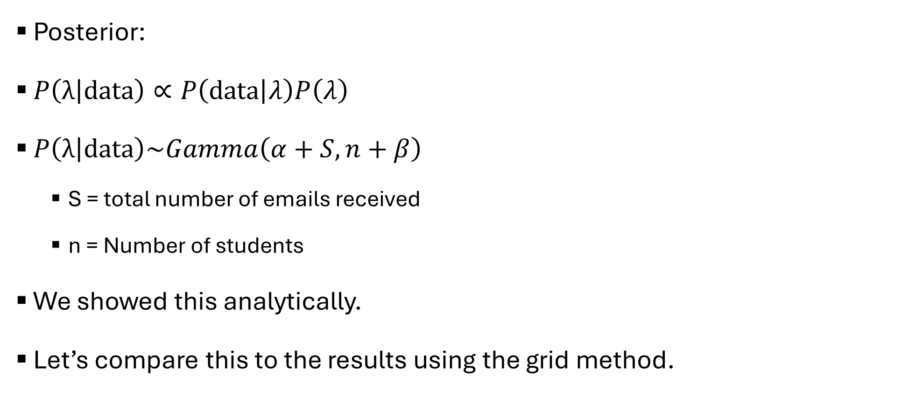
Grid Method
Posterior:
$P\left(\left.λ\right|\text{data}\right)∝P\left(\left.\text{data}\right|λ\right)P\left(λ\right)$
$P\left(\left.λ\right|\text{data}\right)\sim Gamma\left(α+S,n+β\right)$
S = total number of emails received
n = Number of students
We showed this analytically.
Let’s compare this to the results using the grid method.

Slide 7
Grid Method
Steps:
Define a reasonable interval for the parameter (the prior should give you a hint).
Let’s place 100 points between 0-40.
Place a grid of points (generally equidistant) on that interval.
For each point in the grid, multiply the likelihood and the prior.

Slide 8
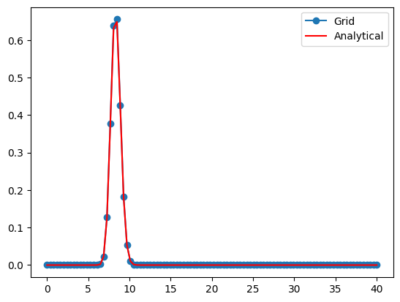
Grid Method
We can see the overlap between the grid method and the analytical results.
We wasted a lot of our grid
sampling values below 5 and
above 10.

Slide 9
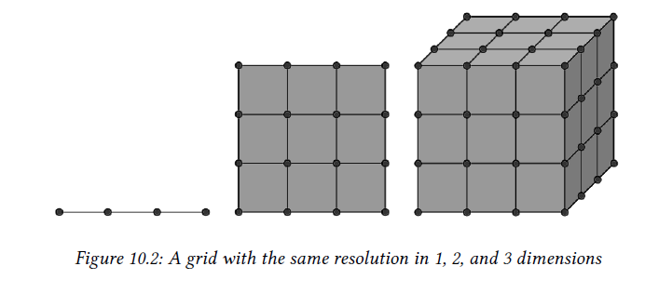
Grid Method
Disadvantages:
We focus equally on all areas of the grid, and not on high probability areas.
Curse of dimensionality

Slide 10
Markovian Chain Monte Carlo Methods (MCMC)
Allow us to get samples from the posterior distribution as long as we can compute the likelihood and the prior pointwise.
Same condition we needed for the grid method.
MCMC methods can efficiently sample from higher-probability regions in very high dimensions.
MCMC methods visit each region of the parameter space following their relative probabilities.
If the probability of region A is twice that of region B, we will obtain twice as many samples from A as we will from B.
Even if we are not capable of computing the whole posterior analytically, we could use MCMC methods to take samples from it.
MCMC will give us samples from the correct distribution asymptotically (for an infinite number of samples).

Slide 11
Markovian Chain Monte Carlo Methods (MCMC)
Monte Carlo methods:
A broad family of algorithms that use random sampling to compute or simulate a given process.
Markovian methods:
Techniques or models based on the Markov property, which is the idea that the future state of a system depends only on its current state, and not on its previous history.
Future outcomes are independent of past events given the present state.

Slide 12
Markovian Chain Monte Carlo Methods (MCMC)
Markov Chain:
A mathematical object that consists of a sequence of states and a set of transition probabilities that describe how to move among the states.
Simple example: flip a coin and if you get heads take a step to the right, otherwise step to the left.
A chain is Markovian if the probability of moving to any other state depends only on the current state.

Slide 13
Metropolis-Hastings
Enables us to obtain samples from any probability distribution given that we can compute at least a value proportional to it.
Thus ignoring the normalization factor.
Useful since often the harder part is to compute the normalization factor.

Slide 14
Metropolis-Hastings
We want to estimate the depth of the bottom of the lake, and find the deepest point.
Lake is muddy so we can’t see.
Take a boat and a stick.
Choose a random place in the lake and move the boat there.
Use the stick to measure the depth of the lake.
Move the boat to another point and take a new measurement.

Slide 15
Metropolis-Hastings
Compare the two measurements:
If the new spot is deeper than the old one -> write it down.
If the old spot was deeper -> either accept or reject the new spot.
Accept = write down the new spot.
Reject = go back to the old spot and write it down again.
6. Move to another point and repeat again and again.

Slide 16
Metropolis-Hastings
What does this give us?
An estimate of the curvature of the bottom of the lake.
An analogy for the posterior.
The deepest point.
An analogy for the mode of the posterior.

Slide 17
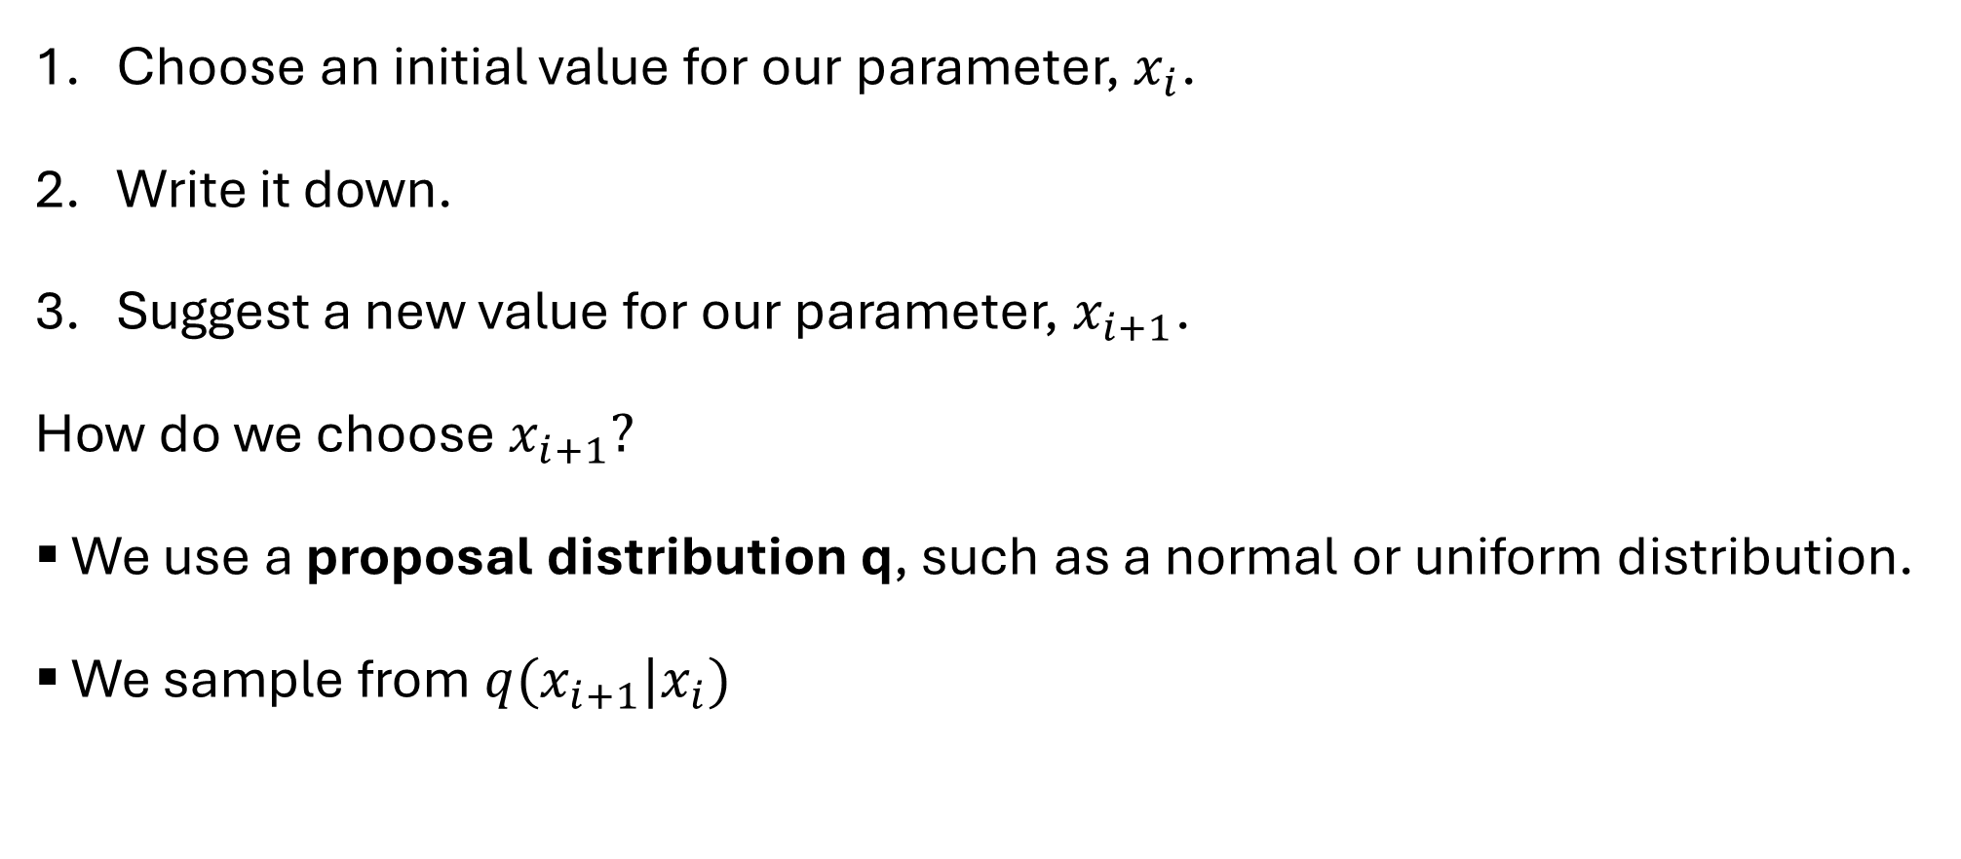
Metropolis-Hastings
Choose an initial value for our parameter, $x_{i}$.
Write it down.
Suggest a new value for our parameter, $x_{i+1}$.
How do we choose $x_{i+1}?$
We use a proposal distribution q, such as a normal or uniform distribution.
We sample from $q(x_{i+1}|x_{i})$

Slide 18
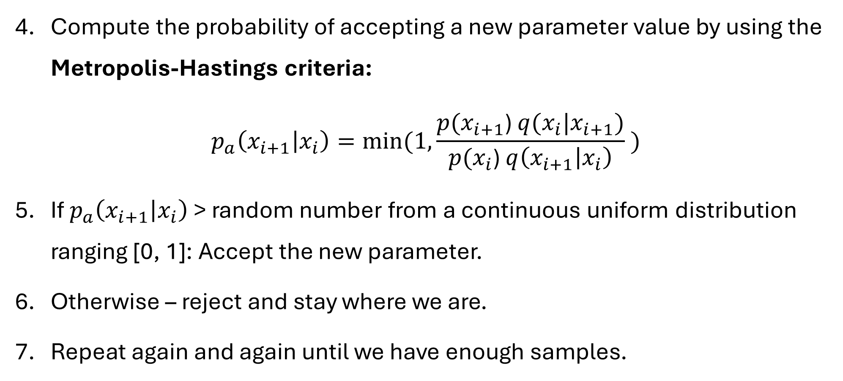
Metropolis-Hastings
Compute the probability of accepting a new parameter value by using the Metropolis-Hastings criteria:
$$p_{a}\left(x_{i+1} | x_{i}\right)=min⁡(1,\frac{p(x_{i+1}\text{) }q(x_{i}|x_{i+1})}{p(x_{i}\text{) }q\left(x_{i+1} | x_{i}\right)} )$$
If $p_{a}\left(x_{i+1} | x_{i}\right)$ > random number from a continuous uniform distribution ranging [0, 1]: Accept the new parameter.
Otherwise – reject and stay where we are.
Repeat again and again until we have enough samples.

Slide 19
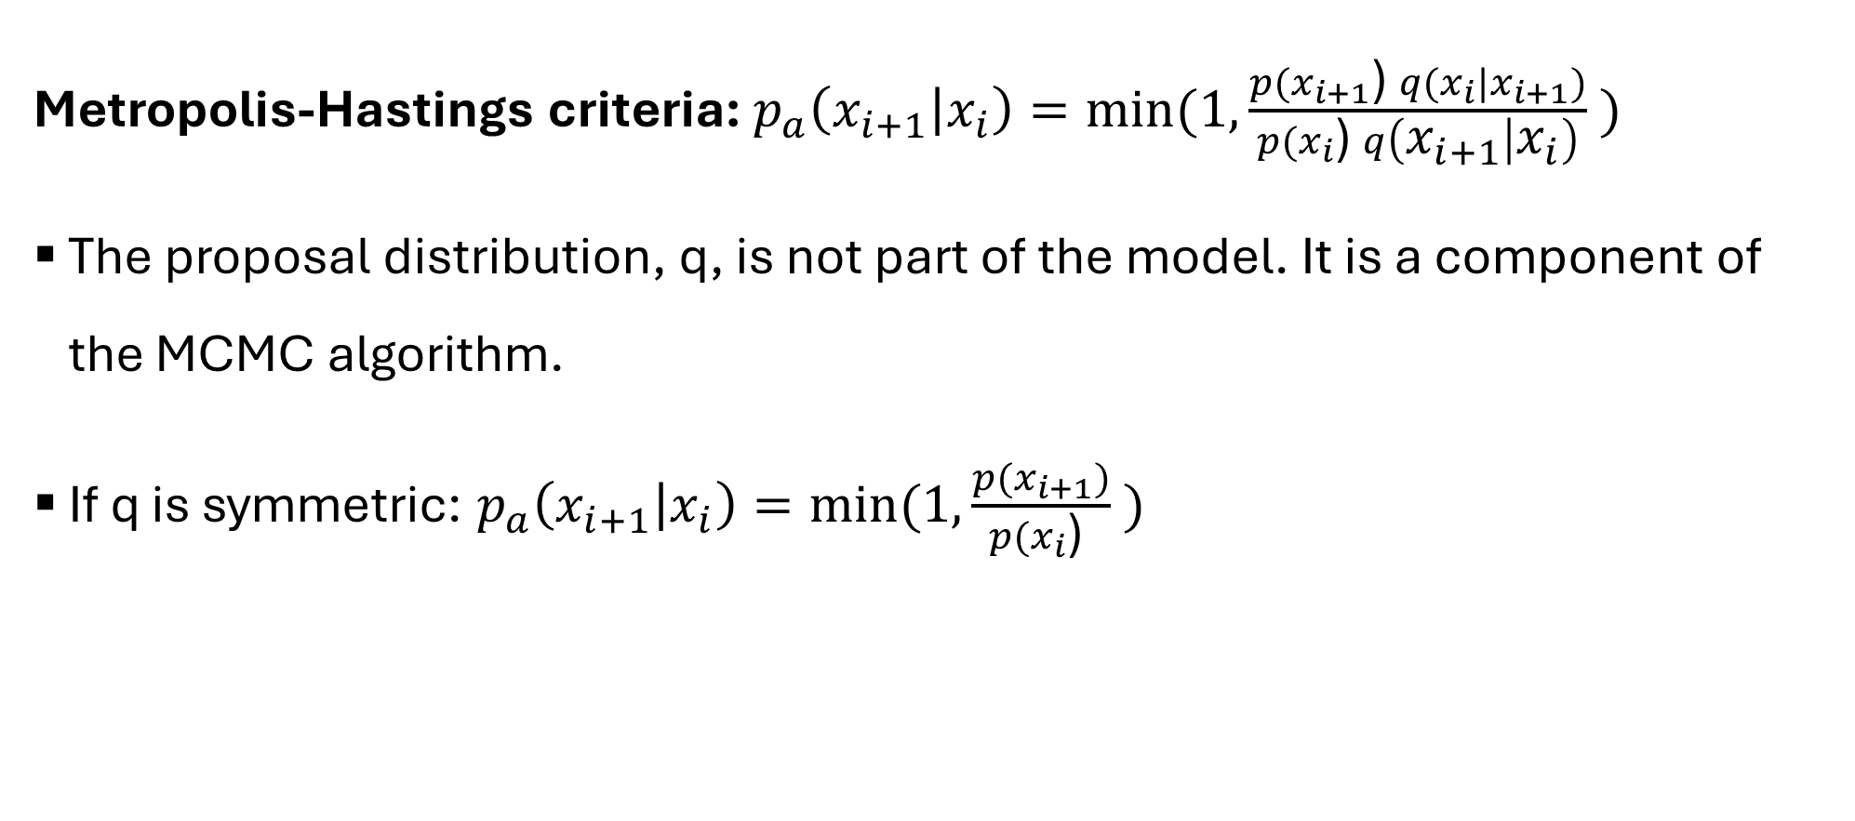
Metropolis-Hastings
Metropolis-Hastings criteria: $p_{a}\left(x_{i+1} | x_{i}\right)=min⁡(1,\frac{p(x_{i+1}\text{) }q(x_{i}|x_{i+1})}{p(x_{i}\text{) }q\left(x_{i+1} | x_{i}\right)} )$
The proposal distribution, q, is not part of the model. It is a component of the MCMC algorithm.
If q is symmetric: $p_{a}\left(x_{i+1} | x_{i}\right)=min⁡(1,\frac{p(x_{i+1})}{p(x_{i}\text{) }} )$

Slide 20
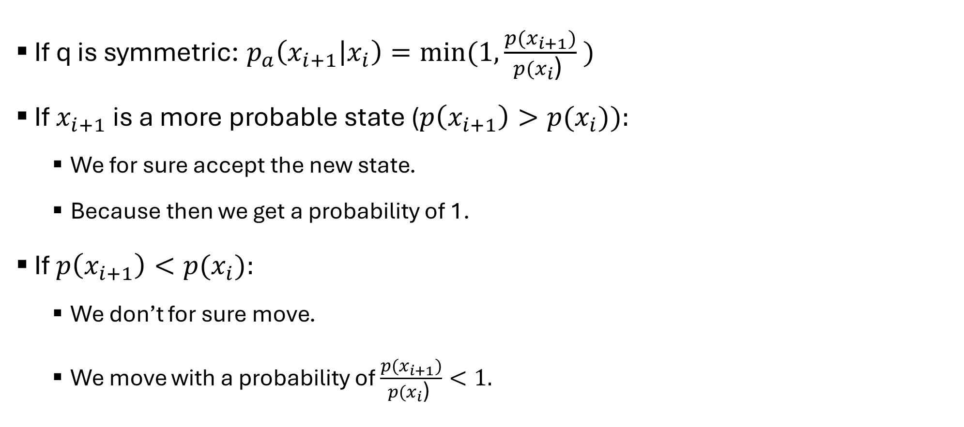
Metropolis-Hastings
If q is symmetric: $p_{a}\left(x_{i+1} | x_{i}\right)=min⁡(1,\frac{p(x_{i+1})}{p(x_{i}\text{) }} )$
If $x_{i+1}$ is a more probable state ($p\left(x_{i+1}\right)>p(x_{i})):$
We for sure accept the new state.
Because then we get a probability of 1.
If $p\left(x_{i+1}\right)<p(x_{i}):$
We don’t for sure move.
We move with a probability of $\frac{p(x_{i+1})}{p(x_{i}\text{) }}<1.$

Slide 21
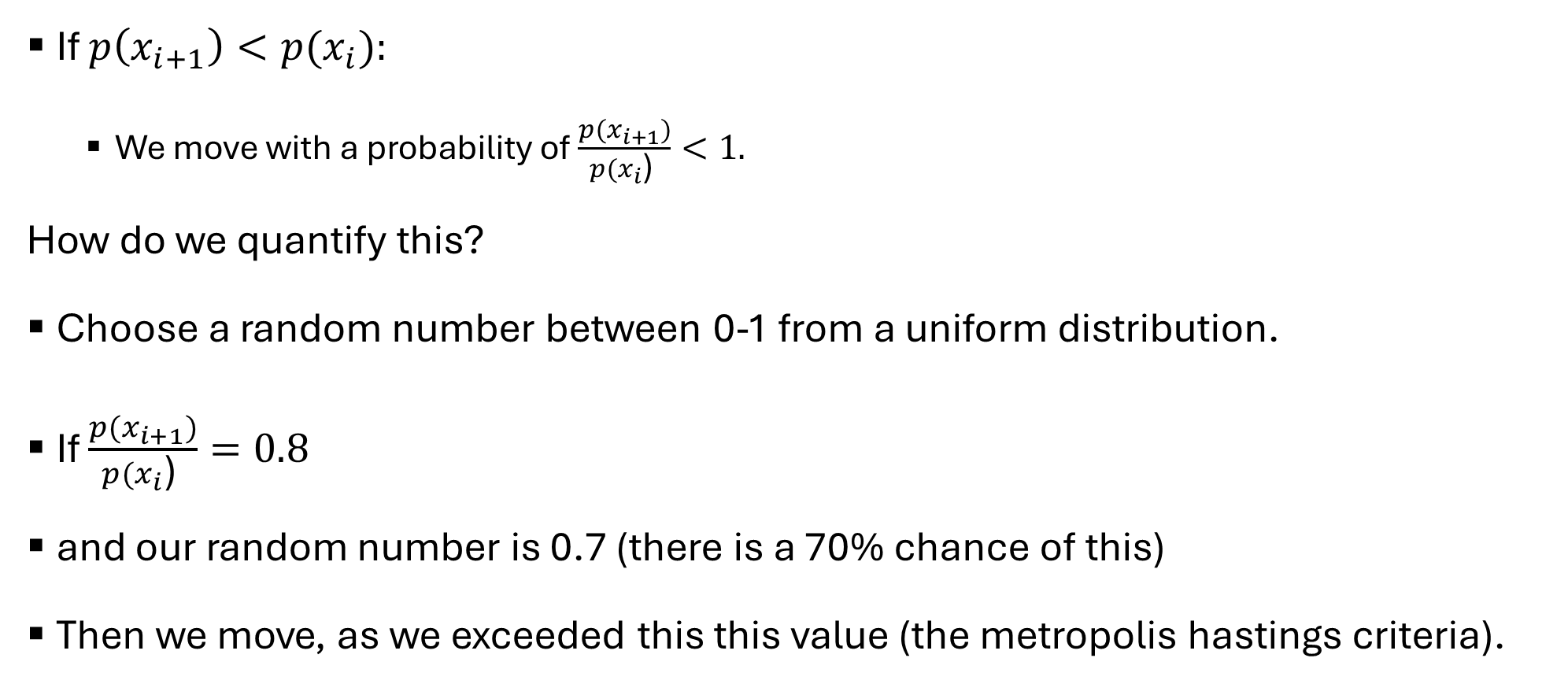
Metropolis-Hastings
If $p\left(x_{i+1}\right)<p(x_{i}):$
We move with a probability of $\frac{p(x_{i+1})}{p(x_{i}\text{) }}<1.$
How do we quantify this?
Choose a random number between 0-1 from a uniform distribution.
If $\frac{p(x_{i+1})}{p(x_{i}\text{) }}=0.8$
and our random number is 0.7 (there is a 70% chance of this)
Then we move, as we exceeded this this value (the metropolis hastings criteria).

Slide 22


Metropolis-Hastings
The island example.
We have 7 islands and we move between them.
The probability we are trying to sample from is $P(θ)∝θ$
$θ$ is the relative number of people on each island.
500
600
700
100
200
300
400
#1
#2
#3
#4
#5
#6
#7

Slide 23
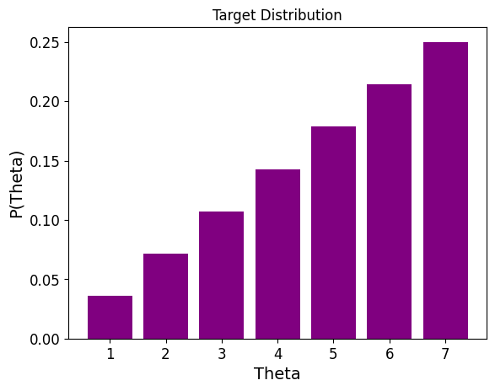

Metropolis-Hastings
The island example.
The probability we are trying to sample from is $P(θ)∝θ$
$θ$ is the relative number of people on each island.

Slide 24
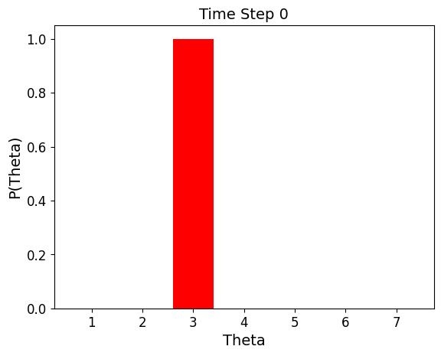

Metropolis-Hastings
Start at a random island
We chose island 3
So we write it down.
#1
#2
#3
#4
#5
#6
#7

Slide 25
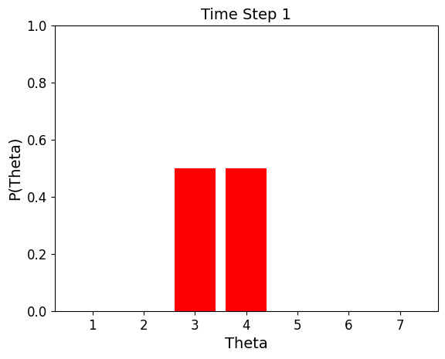
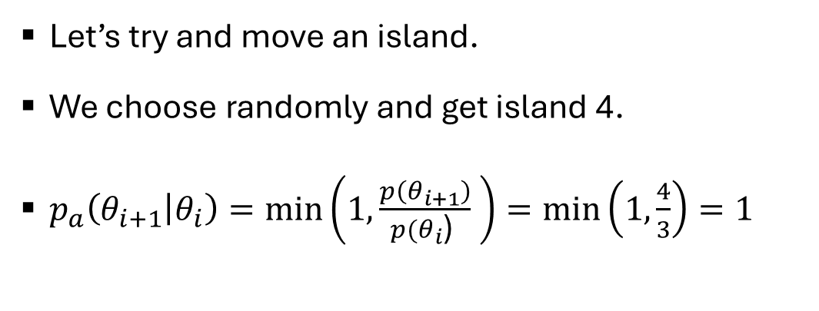
Metropolis-Hastings
Let’s try and move an island.
We choose randomly and get island 4.
$p_{a}\left(θ_{i+1} | θ_{i}\right)=\min\left(1,\frac{p\left(θ_{i+1}\right)}{p(θ_{i}\text{) }} \right)=\min\left(1,\frac{4}{3}\right)=1$
#1
#2
#3
#4
#5
#6
#7

Slide 26
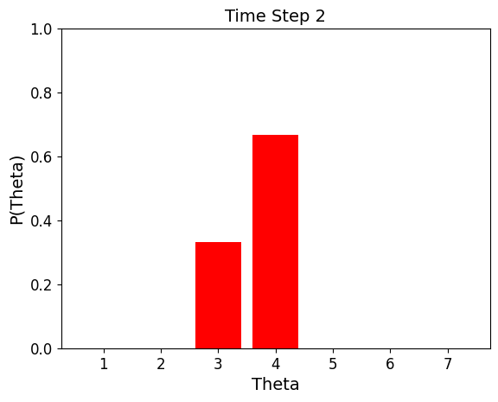
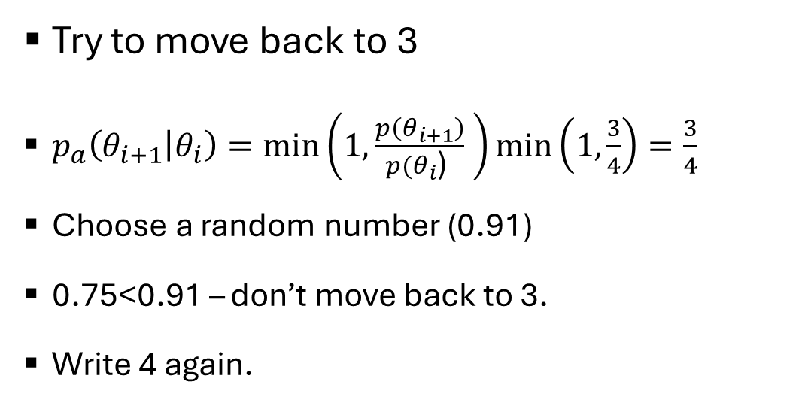
Metropolis-Hastings
Try to move back to 3
$p_{a}\left(θ_{i+1} | θ_{i}\right)=\min\left(1,\frac{p\left(θ_{i+1}\right)}{p(θ_{i}\text{) }} \right)\min\left(1,\frac{3}{4}\right)=\frac{3}{4}$
Choose a random number (0.91)
0.75<0.91 – don’t move back to 3.
Write 4 again.
#1
#2
#3
#4
#5
#6
#7

Slide 27
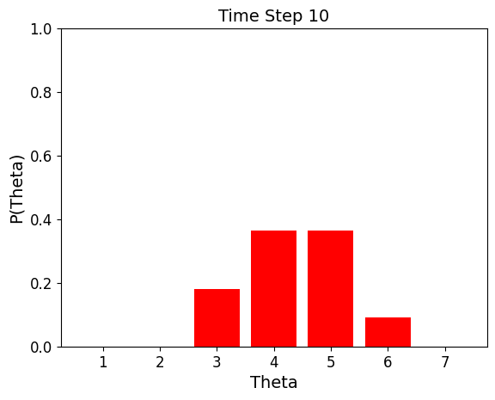
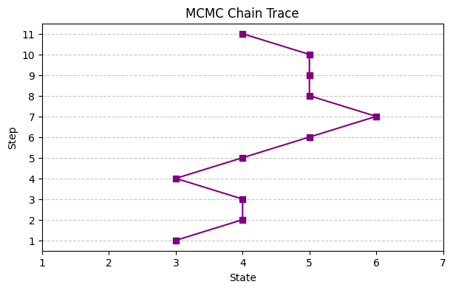
Metropolis-Hastings
#1
#2
#3
#4
#5
#6
#7

Slide 28
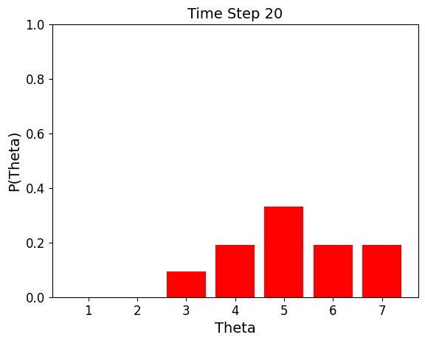
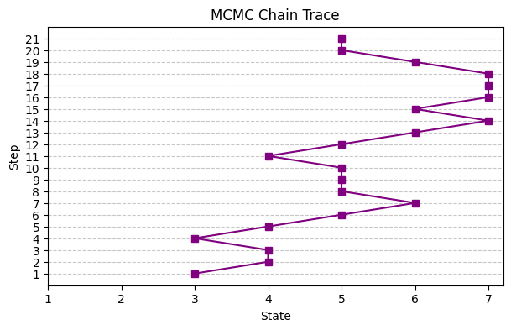
Metropolis-Hastings
#1
#2
#3
#4
#5
#6
#7

Slide 29
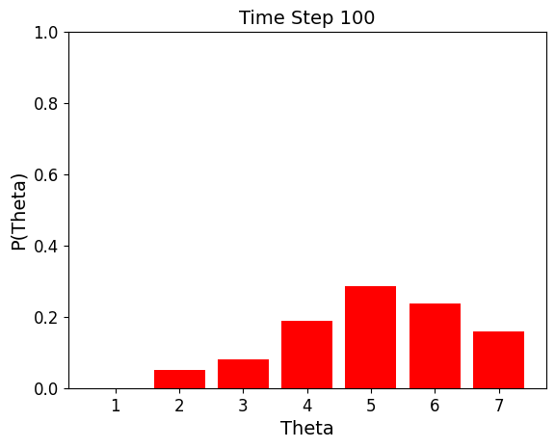
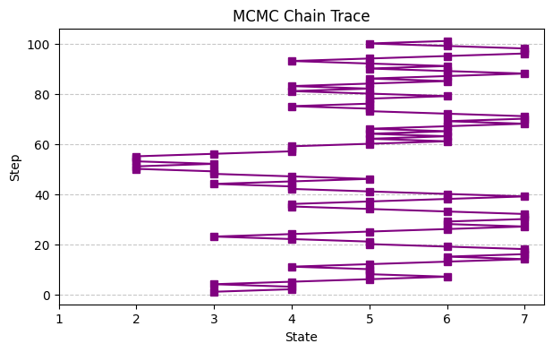
Metropolis-Hastings
#1
#2
#3
#4
#5
#6
#7

Slide 30
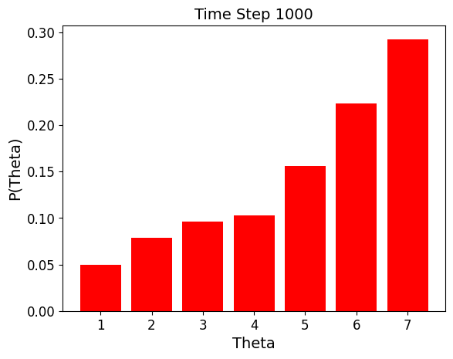
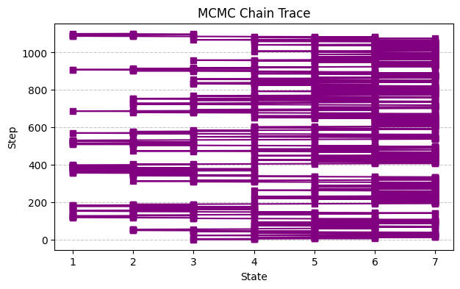
Metropolis-Hastings
#1
#2
#3
#4
#5
#6
#7

Slide 31
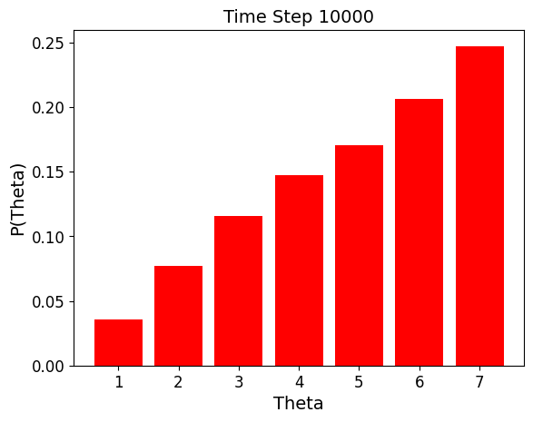
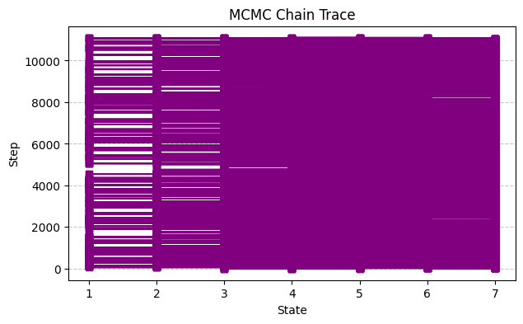
Metropolis-Hastings
#1
#2
#3
#4
#5
#6
#7

Slide 32
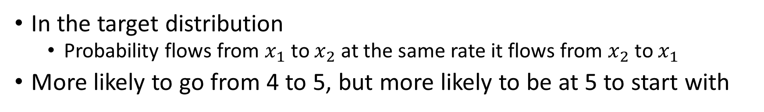

Detailed balance
In the target distribution
Probability flows from $x_{1}$ to $x_{2}$ at the same rate it flows from $x_{2}$ to $x_{1}$
More likely to go from 4 to 5, but more likely to be at 5 to start with
In the example ($p\left(θ\right)∝θ$):
Notes:
These slides explain why we stay at the target distribution once we get there

Slide 33
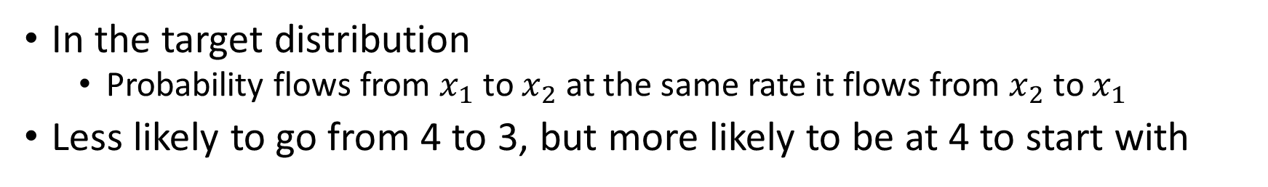
Detailed balance
In the target distribution
Probability flows from $x_{1}$ to $x_{2}$ at the same rate it flows from $x_{2}$ to $x_{1}$
Less likely to go from 4 to 3, but more likely to be at 4 to start with

Slide 34
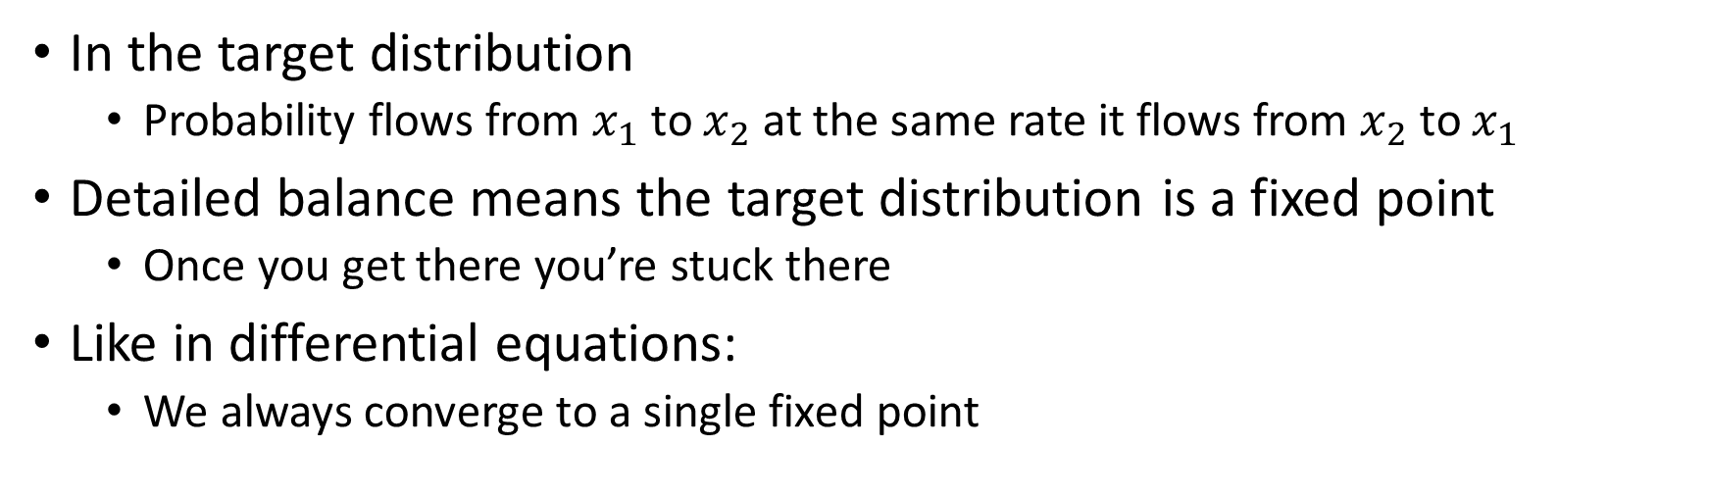
Detailed balance
In the target distribution
Probability flows from $x_{1}$ to $x_{2}$ at the same rate it flows from $x_{2}$ to $x_{1}$
Detailed balance means the target distribution is a fixed point
Once you get there you’re stuck there
Like in differential equations:
We always converge to a single fixed point

Slide 35


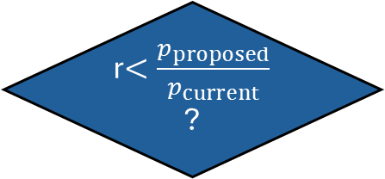
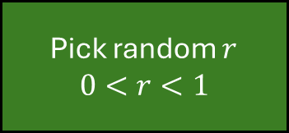

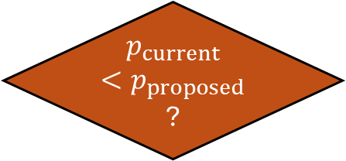
Metropolis-Hastings
Yes
Go to
$$θ_{proposed}$$
Pick next place$θ_{proposed}, p_{proposed}$
$p_{current}<p_{proposed}$?
Yes
No
Pick random $r$
$$0<r<1$$
r$<\frac{p_{proposed}}{p_{current}}$?
No
Go to
$$θ_{current}$$
Notes:
If you take a bunch of MCMC samples, they will distribute like the posterior. Each step distributes like the one before it conditioned on the selection function. Taken together as a whole, with the order permuted.
The process will look different if you start at a different state but end up at the same place.
The distribution will depend on the starting point, so that is why there is the burn in (default 1000).
Given any target distribution- if you want to sample from that target distribution you can use mcmc.

Slide 36
Metropolis-Hastings
How do we choose a proposal function?
The proposal function has to be scaled appropriately.
If we have a very broad proposal for a narrow posterior, all the proposals are to a place with no probability and we never accept a new state.
If your proposal is very narrow, get stuck near the starting point and explore that excessively.
We often use a normal distribution N(0, sigma) and tune the sigma.
We can run the algorithm with an acceptance rate in mind (~70%-80%).
Look how many of the first N steps were accepted.
If the proposal is too narrow – we’ll almost always accept.
We’ll see we surpassed the acceptance rate and make the proposal wider.
If the proposal is too wide – we’ll rarely accept.
We’ll see we did not reach the acceptance rate and make the proposal narrower.

Slide 37
Diagnostics
Using numerical methods means we are approximating the posterior with a finite number of samples.
Do we have a valid sample?
We will use tests to see if the sampling algorithm worked.
These tests can spot problems with our samples.
They cannot prove that we have the correct distribution.
They can also provide evidence that the samples seem reasonable.

Slide 38
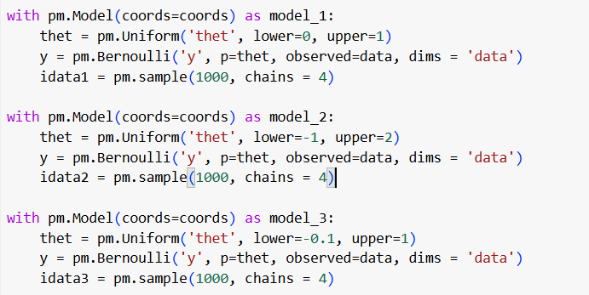
Three Different Priors For the Coin Flip
Notes:
Three different models

Slide 39
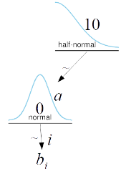
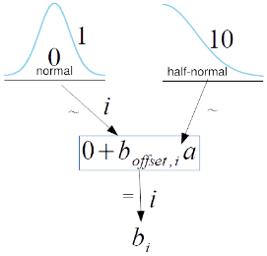
Centered vs. Not Centered Models
Centered Model
Non-Centered Model
coords = {"data": np.arange(10)}
with pm.Model(coords=coords) as model_cm:
a = pm.HalfNormal('a', 10)
b = pm.Normal('b', 0, a, dims='data')
coords = {"data": np.arange(10)}
with pm.Model(coords=coords) as model_ncm:
a = pm.HalfNormal('a', 10)
b_offset = pm.Normal('b_offset', mu=0, sigma=1, dims='data')
b = pm.Deterministic('b', 0 + b_offset * a, dims='data')
Notes:
The difference between model_c and model_nc models is that for the former, we fit the
group-level parameter directly, and for the latter, we model the group-level parameter as a
shifted and scaled Gaussian

Slide 40
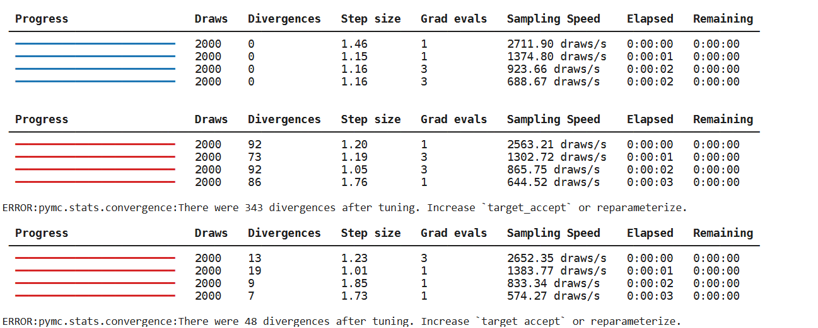
Three Different Priors For the Coin Flip
Notes:
Three different models

Slide 41
Convergence
MCMC methods are guaranteed to converge for infinite samples.
How do we know if we have a reasonable number of samples?
The sampler has converged if the samples are stable.
Run the simulation multiple times and see if we get the same result every time.
We often used four chains.
This is also efficient as we can combine the samples from the different chains to have four times as many samples.

Slide 42
Convergence
How do we check convergence?
Look at the trace plots and see if the chains look similar

Slide 43
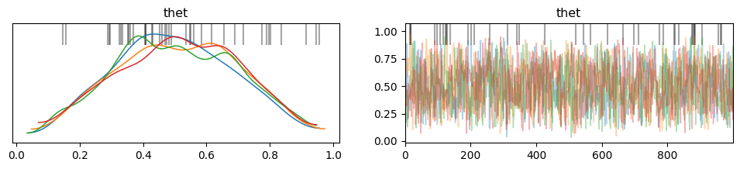
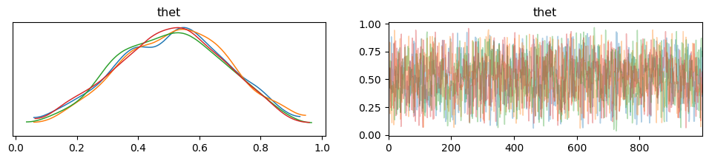
Less good:
Better:

Slide 44
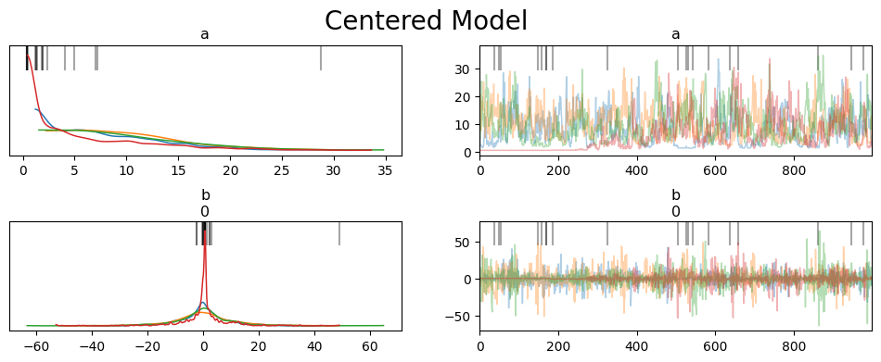
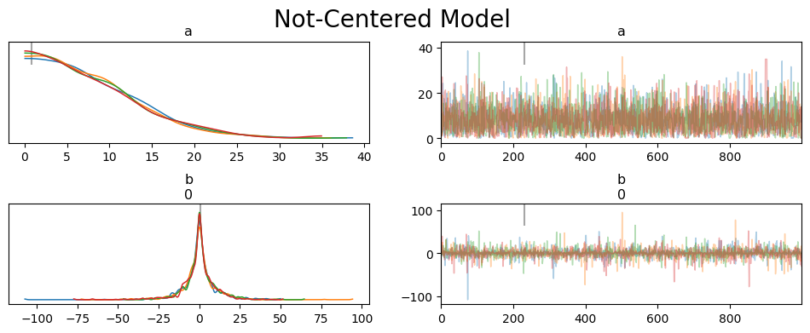
Less good:
Better:

Slide 45
Convergence
How do we check convergence?
Look at the trace plots and see if the chains look similar
Overlapping KDE chains
Trace plots that look noisy, mixed and like they explored the different values.
The overlapping and mixing means that even when the different chains start from different points, they all describe the same distribution.

Slide 46
Convergence
Rank plots
When it’s hard to read the trace plot, we can use rank plots.
To build a rank plot for a parameter, we:
Take all the samples from all the chains
Order them, and number them according to order (sample 0, sample 1…)
Plot one histogram per chain
If the chains are sampled from the same distribution, all the chains should have the same number of low, medium, and high ranks (and all ranks in between)
So we want the histograms to look uniform

Slide 47
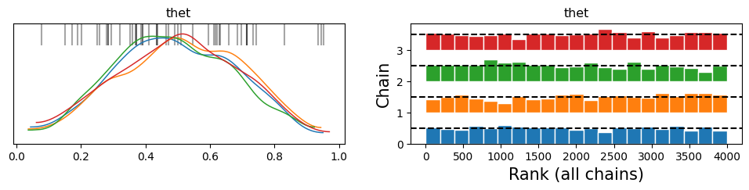
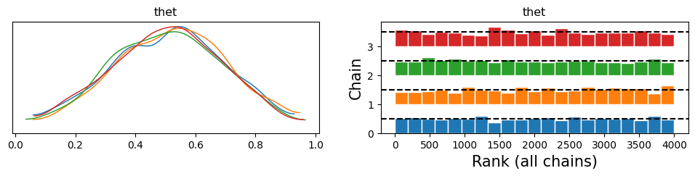
Less good:
Better:

Slide 48
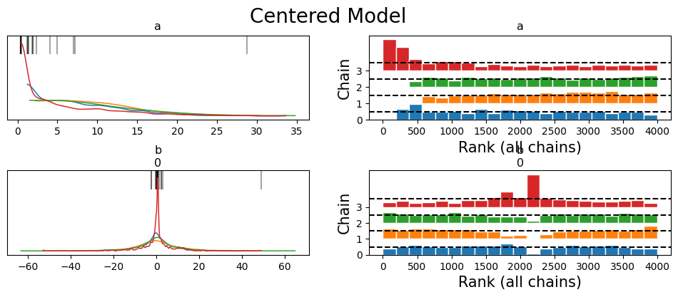
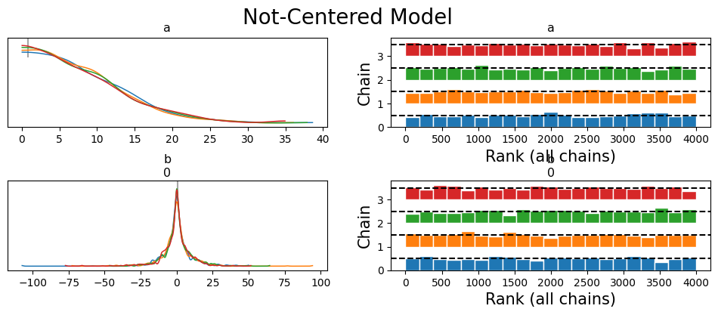
Less good:
Better:

Slide 49
Convergence
How do we check convergence?
Look at the trace plots and see if the chains look similar
Overlapping KDE chains
Trace plots that look noisy, mixed and like they explored the different values.
Rank plots
Do they look uniform?
These are both visual methods.

Slide 50

Convergence
How do we check convergence?
Rhat ($\hat{R})$
Compare the variance between chains with the variance within the chains.
Ideally should be 1 (the variance between the chains is not more than the variance within the chains)
Values below 1.1.

Slide 51
Convergence
How do we check convergence?
Look at the trace plots and see if the chains look similar
Overlapping KDE chains
Trace plots that look noisy, mixed and like they explored the different values.
Rhat
Below 1.1
Effective Sample Size

Slide 52
Convergence
Autocorrelation
How much can you predict this sample from the previous one?
How far away do you have to get for a truly independent sample?

Slide 53
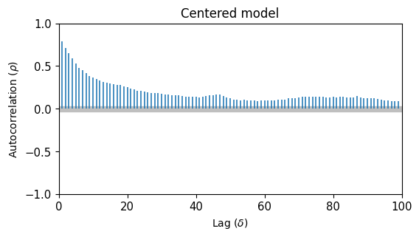

Less good:
Better:

Slide 54
Convergence
How do we check convergence?
Look at the trace plots and see if the chains look similar
Overlapping KDE chains
Trace plots that look noisy, mixed and like they explored the different values.
Rhat
Below 1.1
Autocorrelation
?
Effective Sample Size

Slide 55
Convergence
Effective Sample Size
How many useful draws do we have in our sample?
Due to autocorrelation: Number of useful draws < number of samples.
We need an effective sample size of at least 100 per chain (400 for 4 chains).
We’ll use at least 500
The effective sample size is the number of samples, corrected for the autocorrelation.

Slide 56
Convergence
How do we check convergence?
Look at the trace plots and see if the chains look similar
Overlapping KDE chains
Trace plots that look noisy, mixed and like they explored the different values.
Rhat
Below 1.1
Effective Sample Size
At least 100 per chain
Monte Carlo Standard Error

Slide 57
Convergence
Monte Carlo Standard Error
Width of the posterior divided by the square root of the effective sample size.
Indication of how well we are measuring the parameter.
Should be less than 1%-2%.

Slide 58
Convergence
How do we check convergence?
Look at the trace plots and see if the chains look similar
Overlapping KDE chains
Trace plots that look noisy, mixed and like they explored the different values.
Rhat
Below 1.1
Effective Sample Size
At least 100 per chain
Monte Carlo Standard Error
Below 1-2%.

Slide 59


Less good:
Better:
Notes:
ESS bulk is how well the center of the distribution was resolved – relevant for the mean, median…
If we are interested in posterior intervales, or rare events – ess tail, which is computed as the minimum ESS at the percentiles 5 and 95.
You can also get the ESS at specific quantiles using az.ess(…method = ‘quantile). , or plot for any quantiles at the same time using az.plot_ess(…, kind = ‘quantiles’).

Slide 60
Convergence
What do we do if there is no convergence?
Check our codes.
Increase number of samples.
Increase number of tuning samples.
Change the model
Try a simpler model
Change the priors
Change the parameters
Notes:
Number of default tuning samples is 1000.
pymc.sample(draws=1000, *, tune=1000, chains=None)

Slide 61
Divergence
If there are divergences, it indicates that the sampler has likely found a region of high curvature in the posterior that cannot be explored properly.
Only for the NUTS sampler (based on the Hamiltonian Monte Carlo method).
We can try and reparametrize the model.
We can increase target accept in pm.sample.
Notes:
It is a parameter that controls the tuning of the NUTS sampler in PyMC. It controls the
acceptance rate of the proposed samples, which defaults to 0.8. This means accepting
80% of the proposed samples. The NUTS sampler adaptively adjusts the step size of the
Hamiltonian dynamics simulation to achieve the target acceptance rate. 80% is a good
default, but for some models, you may want to try larger values like 0.90, 0.95, 0.99, or even
0.999 if you refuse to lose all hope.

Slide 62

Divergence
That was for a default target_accept = 0.8
Increase to 0.9

Slide 63


Divergence

Slide 64


Less good:
Better:

Slide 65


Less good:
Better:
Notes:
ESS bulk is how well the center of the distribution was resolved – relevant for the mean, median…
If we are interested in posterior intervales, or rare events – ess tail, which is computed as the minimum ESS at the percentiles 5 and 95.
You can also get the ESS at specific quantiles using az.ess(…method = ‘quantile). , or plot for any quantiles at the same time using az.plot_ess(…, kind = ‘quantiles’).

Slide 66
Convergence
What do we do if there is a convergence?
Check our codes.
Increase number of samples.
Increase number of tuning samples.
Change the model
Try a simpler model
Change the priors
Change the parameters
Notes:
Number of default tuning samples is 1000.
pymc.sample(draws=1000, *, tune=1000, chains=None)

Slide 67
Divergence
If there are divergences, it indicates that the sampler has likely found a region of high curvature in the posterior that cannot be explored properly.
Only for the NUTS sampler (based on the Hamiltonian Monte Carlo method).
We can try and reparametrize the model.
We can increase target accept in pm.sample.
Notes:
It is a parameter that controls the tuning of the NUTS sampler in PyMC. It controls the
acceptance rate of the proposed samples, which defaults to 0.8. This means accepting
80% of the proposed samples. The NUTS sampler adaptively adjusts the step size of the
Hamiltonian dynamics simulation to achieve the target acceptance rate. 80% is a good
default, but for some models, you may want to try larger values like 0.90, 0.95, 0.99, or even
0.999 if you refuse to lose all hope.

Slide 68


Divergence
Where do we see them?
Notes:
Black dots in 3

